Slide 1
Propositional Logic: Review

Slide 2
A knowledge-based agent
A knowledge-based agent includes a knowledge base and an inference system.
A knowledge base is a set of representations of facts of the world.
Each individual representation is called a sentence.
The sentences are expressed in a knowledge representation language.
The agent operates as follows:
  1. It TELLs the knowledge base what it perceives.
  2. It ASKs the knowledge base what action it should perform.
  3. It performs the chosen action.
Examples of sentences
  The moon is made of green cheese
  If A is true then B is true
  A is false
  All humans are mortal
  Confucius is a human

Slide 3
Architecture of a knowledge-based agent
Knowledge Level.
  The most abstract level: describe agent by saying what it knows.
  Example: A taxi agent might know that the Golden Gate Bridge connects San Francisco with the Marin County.
Logical Level.
  The level at which the knowledge is encoded into sentences.
  Example: Links(GoldenGateBridge, SanFrancisco, MarinCounty).
Implementation Level.
  The physical representation of the sentences in the logical level.
  Example: ‘(links goldengatebridge sanfrancisco marincounty)

Slide 4
The Inference engine derives new sentences from the input and KB
The inference mechanism depends on representation in KB
The agent operates as follows:
  1. It receives percepts from environment
  2. It computes what action it should perform (by IE and KB)
  3. It performs the chosen action (some actions are simply inserting inferred new facts into KB).
Input from
environment
Inference
Engine
Output
(actions)
Learning
(KB update)
Knowledge
Base

Slide 5
KB can be viewed at different levels
Knowledge Level.
  The most abstract level -- describe agent by saying what it knows.
  Example: A taxi agent might know that the Golden Gate Bridge connects San Francisco with the Marin County.
Logical Level.
  The level at which the knowledge is encoded into sentences.
  Example: Links(GoldenGateBridge, SanFrancisco, MarinCounty).
Implementation Level.
  The physical representation of the sentences in the logical level.
  Example: “(Links GoldenGateBridge, SanFrancisco, MarinCounty)”
review

Slide 6
Knowledge representation
The objective of knowledge representation is to express the knowledge about the world in a computer-tractable form
• Key aspects of knowledge representation languages:
-Syntax: describes how sentences are formed in the language
Semantics: describes the meaning of sentences, what is it the sentence refers to in the real world
- Computational aspect: describes how sentences and objects are manipulated in concordance with semantical conventions Many KB systems rely on some variant of logic

Slide 7
The Wumpus World environment
The Wumpus computer game
It was inspired by a video game Hunt the Wumpus by Gregory Yob in 1973.
The agent explores a cave consisting of rooms connected by passageways.
Lurking somewhere in the cave is the Wumpus, a beast that eats any agent that enters its room.
Some rooms contain bottomless pits that trap any agent that wanders into the room.
Occasionally, there is a heap of gold in a room.
The goal is:
  to collect the gold and
  exit the world
  without being eaten

Slide 8
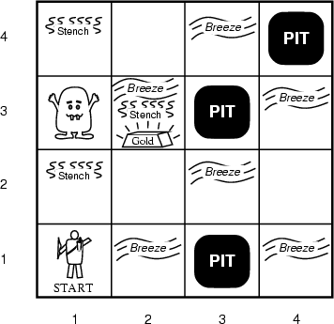
A typical Wumpus world
The agent always starts in the field [1,1].
The task of the agent is to find the gold, return to the field [1,1] and climb out of the cave.

Slide 9
Agent in a Wumpus world: Percepts
The agent perceives
  a stench in the square containing the wumpus and in the adjacent squares (not diagonally)
  a breeze in the squares adjacent to a pit
  a glitter in the square where the gold is
  a bump, if it walks into a wall
  a woeful scream everywhere in the cave, if the wumpus is killed
The percepts will be given as a five-symbol list:
  If there is a stench, and a breeze, but no glitter, no bump, and no scream, the percept is
    [Stench, Breeze, None, None, None]
The agent can not perceive its own location.

Slide 10
The actions of the agent in Wumpus game are:
go forward
turn right 90 degrees
turn left 90 degrees
grab means pick up an object that is in the same square as the agent
shoot means fire an arrow in a straight line in the direction the agent is looking.
  The arrow continues until it either hits and kills the wumpus or hits the wall.
  The agent has only one arrow.
  Only the first shot has any effect.
climb is used to leave the cave.
  Only effective in start field.
die, if the agent enters a square with a pit or a live wumpus.
  (No take-backs!)

Slide 11
The agent’s goal
The agent’s goal is to find the gold and bring it back to the start as quickly as possible, without getting killed.
  1000 points reward for climbing out of the cave with the gold
  1 point deducted for every action taken
  10000 points penalty for getting killed

Slide 12
The Wumpus agent’s first step

Slide 13
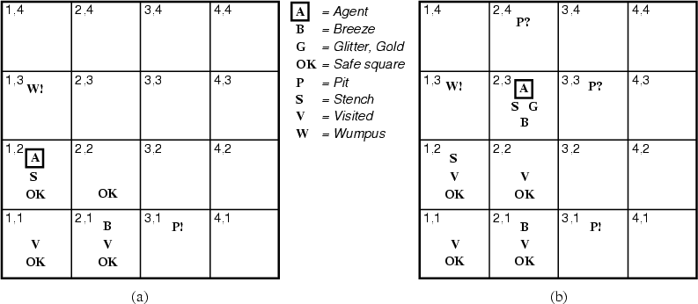
Later

Slide 14
LOGIC
A formal language for expressing knowledge and ways of reasoning. Logic is defined by:
• A set of sentences – A sentence is constructed from a set of primitives according to syntax rules.
• A set of interpretations – An interpretation gives a semantic to primitives. It associates primitives with values.
• The valuation (meaning) function V – Assigns a value (typically the truth value) to a given sentence under some interpretation V : sentence × interpretation → {True , False }

Slide 15
Example Of Logic
Example of logic Language of numerical constraints:
• A sentence:
x + 3 ≤ z x , z - variable symbols (primitives in the language)
• An interpretation: x = 5, z = 2 Variables mapped to specific real numbers
• Valuation (meaning):
V ( x + 3 ≤ z, I) is False for I: x = 5, z = 2 is True
for I: x = 5, z = 10

Slide 16
Big Ideas
Logic is a great knowledge representation language for many AI problems
Propositional logic is the simple foundation and fine for some AI problems
First order logic (FOL) is much more expressive as a KR language and more commonly used in AI
There are many variations: horn logic, higher order logic, three-valued logic, probabilistic logics, etc.

Slide 17
Propositional logic Syntax s
• Propositional logic P: – defines a language for symbolic reasoning
• Proposition: a statement that is either true or false
• Examples of propositions:
– France is in Europe.
– It rains outside.
– 2 is a prime number and 6 is a prime
– How are you? Not a proposition.

Slide 18
Propositional logic
Logical constants: true, false
Propositional symbols: P, Q,... (atomic sentences)
Wrapping parentheses: ( … )
Sentences are combined by connectives:
  ∧and [conjunction]
  ∨ or [disjunction]
  ⇒ implies [implication / conditional]
  ⇔ is equivalent [biconditional]
  ¬ not [negation]
Literal: atomic sentence or negated atomic sentence
  P, ¬ P

Slide 19
Examples of PL sentences
(P ∧ Q) → R
  “If it is hot and humid, then it is raining”
Q → P
  “If it is humid, then it is hot”
Q
  “It is humid.”
We’re free to choose better symbols, btw:
  Ho = “It is hot”
  Hu = “It is humid”
  R = “It is raining”

Slide 20
Propositional logic (PL)
Simple language for showing key ideas and definitions
User defines set of propositional symbols, like P and Q
User defines semantics of each propositional symbol:
  P means “It is hot”, Q means “It is humid”, etc.
A sentence (well formed formula) is defined as follows:
  A symbol is a sentence
  If S is a sentence, then ¬S is a sentence
  If S is a sentence, then (S) is a sentence
  If S and T are sentences, then (S ∨ T), (S ∧ T), (S → T), and (S ↔ T) are sentences
  A sentence results from a finite number of applications of the rules

Slide 21
Some terms
The meaning or semantics of a sentence determines its interpretation
Given the truth values of all symbols in a sentence, it can be “evaluated” to determine its truth value (True or False)
A model for a KB is a possible world – an assignment of truth values to propositional symbols that makes each sentence in the KB True

Slide 22
Model for a KB
Let the KB be [P∧Q→R, Q → P]
What are the possible models? Consider all possible assignments of T|F to P, Q and R and check truth tables
  FFF: OK
  FFT: OK
  FTF: NO
  FTT: NO
  TFF: OK
  TFT: OK
  TTF: NO
  TTT: OK
If KB is [P∧Q→R, Q → P, Q], then the only model is TTT
P: it’s hot
Q: it’s humid
R: it’s raining

Slide 23
More terms
A valid sentence or tautology is a sentence that is True under all interpretations, no matter what the world is actually like or what the semantics is. Example: “It’s raining or it’s not raining”
An inconsistent sentence or contradiction is a sentence that is False under all interpretations. The world is never like what it describes, as in “It’s raining and it’s not raining.”
P entails Q, written P |= Q, means that whenever P is True, so is Q. In other words, all models of P are also models of Q.

Slide 24


Truth tables
Truth tables are used to define logical connectives
and to determine when a complex sentence is true given the values of the symbols in it
Truth tables for the five logical connectives
Example of a truth table used for a complex sentence

Slide 25
On the implies connective: P → Q
Note that → is a logical connective
So P→Q is a logical sentence and has a truth value, i.e., is either true or false
If we add this sentence to the KB, it can be used by an inference rule, Modes Ponens, to derive/infer/prove Q if P is also in the KB
Given a KB where P=True and Q=True, we can also derive/infer/prove that P→Q is True

Slide 26
P → Q
When is P→Q true? Check all that apply
  P=Q=true
  P=Q=false
  P=true, Q=false
  P=false, Q=true

Slide 27
P → Q
When is P→Q true? Check all that apply
  P=Q=true
  P=Q=false
  P=true, Q=false
  P=false, Q=true
We can get this from the truth table for →
✔
✔
✔

Slide 28
Inference rules
Logical inference creates new sentences that logically follow from a set of sentences (KB)
An inference rule is sound if every sentence X it produces when operating on a KB logically follows from the KB
  i.e., inference rule creates no contradictions
An inference rule is complete if it can produce every expression that logically follows from (is entailed by) the KB.
  Note analogy to complete search algorithms

Slide 29
Sound rules of inference
Here are some examples of sound rules of inference
Each can be shown to be sound using a truth table
  RULE PREMISE CONCLUSION
  Modus Ponens A, A → B B
  And Introduction A, B A ∧ B
  And Elimination A ∧ B A
  Double Negation ¬¬A A
  Unit Resolution A ∨ B, ¬B A
  Resolution A ∨ B, ¬B ∨ C A ∨ C

Slide 30
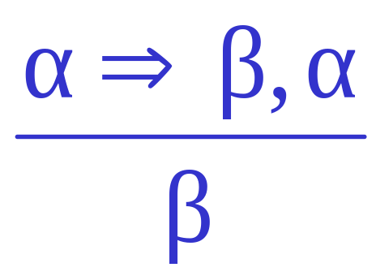
Inference Rules
Modus Ponens or Implication Elimination
From two sentences α ⇒ β and α that are true (so called axioms) the new true sentence β can be concluded (a theorem is proved with respect to the axioms, i.e. the theorem logically follows from the axioms).

Slide 31
Inference Rules
Example:
Sentence: If sun shines it is warm
A – “sun shines”; B – “it is warm”.
Axioms: A ⇒ B
A
Theorem: B, i.e., “it is warm”.

Slide 32
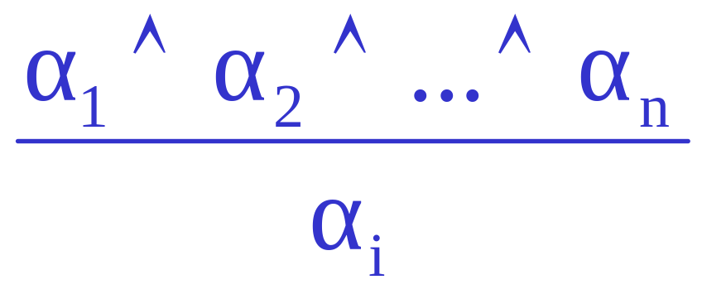
Inference Rules
AND-Elimination
From a conjunction of sentences any of conjuncts can be inferred.

Slide 33
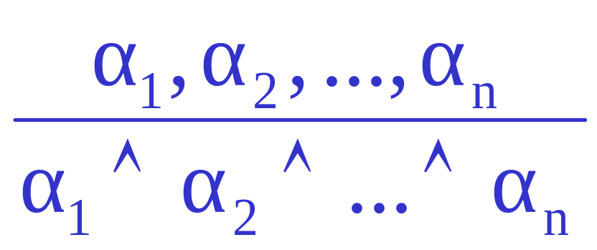
Inference Rules
AND-Introduction
From a list of sentences their conjunction can be inferred.

Slide 34
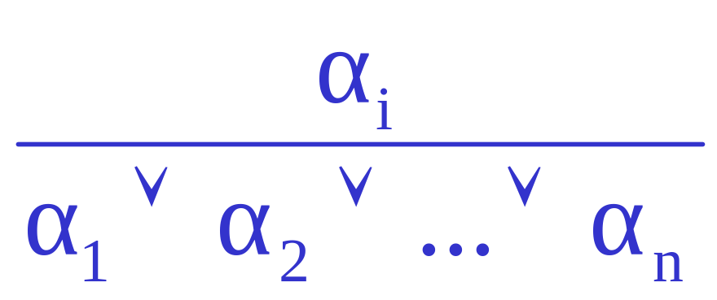
Inference Rules
OR-Introduction
From a sentence its disjunction with anything else at all can be inferred.

Slide 35
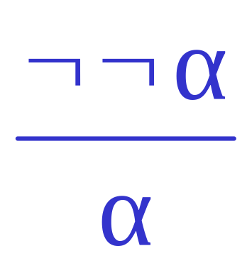
Inference Rules
Double-Negation Elimination
From a double negated sentence a positive sentence can be inferred.

Slide 36
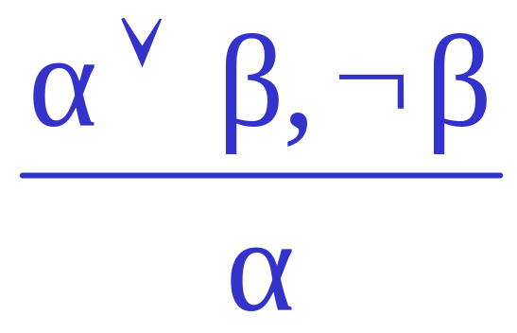
Inference Rules
Unit Resolution
From a disjunction, if one of the disjuncts is false it can be inferred that the other one is true.

Slide 37
Soundness of modus ponens
A | B | A → B | OK?
True | True | True | √
True | False | False | √
False | True | True | √
False | False | True | √

Slide 38
Resolution
Resolution is a valid inference rule producing a new clause implied by two clauses containing complementary literals
  A literal is an atomic symbol or its negation, i.e., P, ~P
This is the only inference rule you need to build a sound and complete theorem prover
  Based on proof by contradiction and usually called resolution refutation
The resolution rule was discovered by Alan Robinson (CS, U. of Syracuse) in the mid 60s

Slide 39
Resolution
A KB is actually a set of sentences all of which are true, i.e., a conjunction of sentences.
To use resolution, put KB into conjunctive normal form (CNF), where each sentence written as a disjunc- tion of (one or more) literals
Example
  KB: [P→Q , Q→R∧S]
  KB in CNF: [~P∨Q , ~Q∨R , ~Q∨S]
  Resolve KB(1) and KB(2) producing: ~P∨R (i.e., P→R)
  Resolve KB(1) and KB(3) producing: ~P∨S (i.e., P→S)
  New KB: [~P∨Q , ~Q∨~R∨~S , ~P∨R , ~P∨S]
Tautologies
(A→B)↔(~A∨B)
(A∨(B∧C)) ↔(A∨B)∧(A∨C)

Slide 40
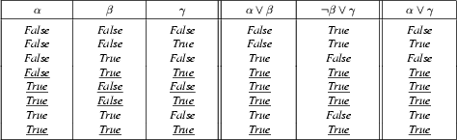
Soundness of the resolution inference rule
From the rightmost three columns of this truth table, we can see that
    (α ∨ β) ∧ (β ∨ γ) ↔ (α ∨ γ)
is valid (i.e., always true regardless of the truth values assigned to α, β and γ

Slide 41
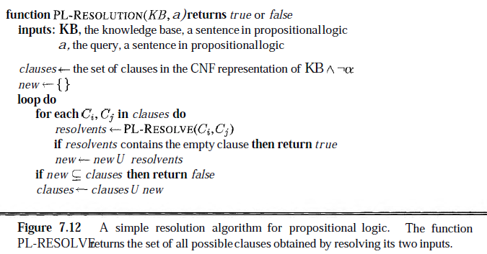
Simple Resolution Algorithm for PL

Slide 42
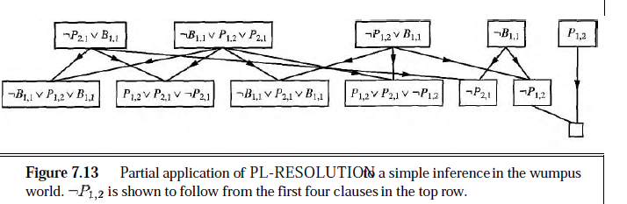
Application of PL Resolution

Slide 43
Proving things
A proof is a sequence of sentences, where each is a premise or is derived from earlier sentences in the proof by an inference rule
The last sentence is the theorem (also called goal or query) that we want to prove
Example for the “weather problem”
  1 Hu premise “It’s humid”
  2 Hu→Ho premise “If it’s humid, it’s hot”
  3 Ho modus ponens(1,2) “It’s hot”
  4 (Ho∧Hu)→R premise “If it’s hot & humid, it’s raining”
  5 Ho∧Hu and introduction(1,3) “It’s hot and humid”
  6 R modus ponens(4,5) “It’s raining”

Slide 44
Entailment and derivation
Entailment: KB |= Q
  Q is entailed by KB (set sentences) iff there is no logically possible world where Q is false while all the sentences in KB are true
  Or, stated positively, Q is entailed by KB iff the conclusion is true in every logically possible world in which all the premises in KB are true
Derivation: KB |- Q
  We can derive Q from KB if there’s a proof consisting of a sequence of valid inference steps starting from the premises in KB and resulting in Q

Slide 45
Two important properties for inference
Soundness: If KB |- Q then KB |= Q
  If Q is derived from KB using a given set of rules of inference, then Q is entailed by KB
  Hence, inference produces only real entailments, or any sentence that follows deductively from the premises is valid
Completeness: If KB |= Q then KB |- Q
  If Q is entailed by KB, then Q can be derived from KB using the rules of inference
  Hence, inference produces all entailments, or all valid sentences can be proved from the premises

Slide 46
PL Example
Consider the problem of representing the following information:
  Every person is mortal.
  Confucius is a person.
  Confucius is mortal.
How can these sentences be represented so that we can infer the third sentence from the first two?

Slide 47
PL Example
In PL we have to create propositional symbols to stand for all or part of each sentence, e.g.:
  P = “person”; Q = “mortal”; R = “Confucius”
The above 3 sentences are represented as:
  P → Q; R → P; R → Q
The 3rd sentence is entailed by the first two, but we need an explicit symbol, R, to represent an individual, Confucius, who is a member of the classes person and mortal
Representing other individuals requires introducing separate symbols for each, with some way to represent the fact that all individuals who are “people” are also “mortal”

Slide 48
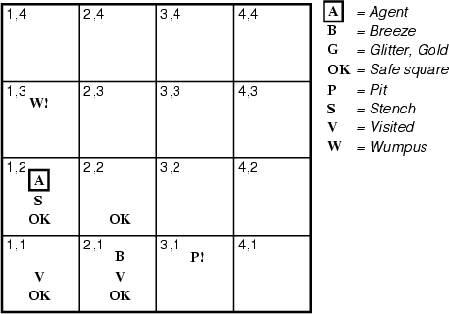
Hunt the Wumpus domain
Some atomic propositions:
  S12 = There is a stench in cell (1,2)
  B34 = There is a breeze in cell (3,4)
  W13 = Wumpus is in cell (1,3)
  V11 = We’ve visited cell (1,1)
  OK11 = Cell (1,1) is safe.
  …
Some rules:
  (R1) ¬S11 → ¬W11 ∧ ¬ W12 ∧ ¬ W21
  (R2) ¬ S21 → ¬W11 ∧ ¬ W21 ∧ ¬ W22 ∧ ¬ W31
  (R3) ¬ S12 → ¬W11 ∧ ¬ W12 ∧ ¬ W22 ∧ ¬ W13
  (R4) S12 → W13 ∨ W12 ∨ W22 ∨ W11
  …
The lack of variables requires us to give similar rules for each cell!

Slide 49
After the third move
We can prove that the Wumpus is in (1,3) using the four rules given.

Slide 50
Proving W13
Apply Modus Ponen (MP) with ¬S11 and R1:
  ¬ W11 ∧ ¬ W12 ∧ ¬ W21
Apply And-Elimination to this, yielding 3 sentences:
  ¬ W11, ¬ W12, ¬ W21
Apply MP to ~S21 and R2, then apply And-elimination:
  ¬ W22, ¬ W21, ¬ W31
Apply MP to S12 and R4 to obtain:
  W13 ∨ W12 ∨ W22 ∨ W11
Apply Unit resolution on (W13 ∨ W12 ∨ W22 ∨ W11) and ¬W11:
  W13 ∨ W12 ∨ W22
Apply Unit Resolution with (W13 ∨ W12 ∨ W22) and ¬W22:
  W13 ∨ W12
Apply UR with (W13 ∨ W12) and ¬W12:
  W13
QED

Slide 51
Propositional Wumpus hunter problems
Lack of variables prevents stating more general rules
  We need a set of similar rules for each cell
Change of the KB over time is difficult to represent
  Standard technique is to index facts with the time when they’re true
  This means we have a separate KB for every time point

Slide 52
Propositional logic: pro and con
Advantages
  Simple KR language sufficient for some problems
  Lays the foundation for higher logics (e.g., FOL)
  Reasoning is decidable, though NP complete, and efficient techniques exist for many problems
Disadvantages
  Not expressive enough for most problems
  Even when it is, it can very “un-concise”

Slide 53
PL is a weak KR language
Hard to identify “individuals” (e.g., Mary, 3)
Can’t directly talk about properties of individuals or relations between individuals (e.g., “Bill is tall”)
Generalizations, patterns, regularities can’t easily be represented (e.g., “all triangles have 3 sides”)
First-Order Logic (FOL) is expressive enough to represent this kind of information using relations, variables and quantifiers, e.g.,
    Every elephant is gray: ∀ x (elephant(x) → gray(x))
    There is a white alligator: ∃ x (alligator(X) ^ white(X))

Slide 54
PL Example
In PL we have to create propositional symbols to stand for all or part of each sentence, e.g.:
  P = “person”; Q = “mortal”; R = “Confucius”
The above 3 sentences are represented as:
  P → Q; R → P; R → Q
The 3rd sentence is entailed by the first two, but we need an explicit symbol, R, to represent an individual, Confucius, who is a member of the classes person and mortal
Representing other individuals requires introducing separate symbols for each, with some way to represent the fact that all individuals who are “people” are also “mortal”

Slide 55
Propositional logic summary
Inference is the process of deriving new sentences from old
  Sound inference derives true conclusions given true premises
  Complete inference derives all true conclusions from a set of premises
A valid sentence is true in all worlds under all interpretations
If an implication sentence can be shown to be valid, then—given its premise—its consequent can be derived
Different logics make different commitments about what the world is made of and what kind of beliefs we can have
Propositional logic commits only to the existence of facts that may or may not be the case in the world being represented
  Simple syntax and semantics suffices to illustrate the process of inference
  Propositional logic can become impractical, even for very small worlds

